Slide 1
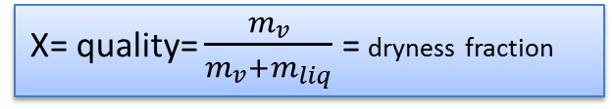
Properties of Pure substances
Air as a mixture of gases is pure. Water and its vapor in a tank is pure, but air and water
vapor in the liquid form in a tank is not pure .
Go to plots> property plot and select the fluid to plot any property in EES
Critical point
Saturated liquid line
Saturated vapor line
Quality line
X= quality= $\frac{m_{v}}{m_{v}+m_{liq}}$ = dryness fraction
vapor
Liquid
For liquid line x=0, for vapor line x=1

Slide 2
Any two states are needed to describe
the thermodynamic property:
U(p,v), u(p,x) u(h,x) u(p,t)
L+v
L
But at the saturated liquid or vapor line
Or inside the dome, P and T both can not be used to determine
any property. Either P or T can be used along with some other variable, say, x
V, s, h
v
v=volume(water, p=500[kpa], x=.8)
v1=volume(steam, t=500[c], s=5.8[kj/kg-c])
Default unit system:

Slide 3
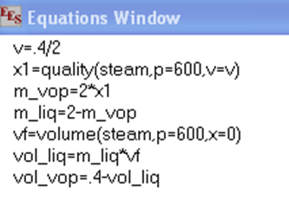
Go to > help > help index> thermo physical property to see the property library in EES
Go to > help > help index> fluid property information to see various fluids for which you can get the property
Real fluid and ideal gases
If you write the name of the fluid as : ‘methane’ then it is treated as real fluid
If you write that as: ‘ch4’ then it is treated as ideal gas
Internal energy and enthalpy of an ideal gas is a function of temp only, so no
other variable is needed if temp is specified.
h=enthalpy(air, t=400) { t is sufficient to find h}
h1=enthalpy(air, v=.2, s=4){ here two variables are needed since t is not given}
Example problem-1
A vessel having a volume of .4m³ contains 2 kg of liquid water and water vapor mixture in equilibrium at a pressure of 600kpa. (a) Find the volume and mass of liquid , (b) volume and mass of vapor

Slide 4

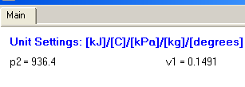
Example problem-2
A rigid vessels contains saturated ammonia vapor at 20C. Heat is transferred to the system until the temp reaches 40C. What is the pressure at this point.
Example problem-3
pf=100+50*g#/area*convert(pa,kpa)
area=pi*d^2/4; d=.1
v1_ac=area*.25; v1=volume(air,p=250,t=300)
m1=v1_ac/v1
t2=temperature(air,p=pf,v=v1) { final temp of air for piston to come down}
v2=v2_ac/m1
v2=volume(air,p=pf,t=20)
h2=v2_ac/area; ht_fall=.25-h2
A piston cylinder arrangement contains air at 250kpa, 300C. The 50kg piston has a dia of .1m and initially pushes against the stops. The atmosphere is at 100kpa, 20C. The cylinder now cools as heat is transferred to the ambient. (a) At what temp does the piston begin to move down, (b) How far has the piston dropped when the temp reaches ambient.

Slide 5
The height of the stops above the bottom of cylinder is 0.25m

